Slide 1

Armed Forces College of Medicine
AFCM

Slide 2
Deep Venous Thrombosis ,Pulmonary embolism &Pulmonary hypertension
Modified by
Dr . Basant Samy
Lecturer of cardiology(AFCM)

Slide 3
Indented Learning Outcomes (ILOs)
By the end of this lecture the student will be able to:
Define of deep venous thrombosis
Identify symptoms and signs of DVT
List different investigatory tools of DVT
Treat DVT
Define , suspect &diagnose pulmonary embolism
Know proper management of pulmonary embolism
Define Pulmonary hypertension and its classes
Method of diagnosis and management of pulmonary hypertension

Slide 4
Deep venous thrombosis (DVT)

Slide 5
Definition
Deep vein thrombosis is the formation of a blood clot in one of the deep veins of the body, usually in the leg

Slide 6
ETIOLOGY
DVT usually originates in the lower extremity venous level ,starting at the calf vein level and progressing proximally to involve popliteal
,femoral ,or iliac system.
80 -90 % pulmonary emboli originates here .

Slide 7
Virchow tried
More than 100 years ago, Virchow described a triad of 3 factors of
Venous stasis,
Endothelial damage, and
Hypercoagulable state

Slide 8
Venous stasis
Prolonged bed rest (4 days or more)
A cast on the leg
Limb paralysis from stroke or spinal cord injury
Extended travel in a vehicle

Slide 9
Endothelial Injury
Trauma
Surgery
Invasive procedure may disrupt venous integrity

Slide 10
Hypercoagulability
Surgery and trauma responsible for up to 40% of all thromboembolic disease
Smoking
Malignancy
Increased estrogen (due to a fall in protein ‘S) Increased estrogen occurs during
All stages of pregnancy—
The first three months postpartum,
After elective abortion, and during treatment with oral contraceptive pills

Slide 11
Hypercoagulability
Inherited disorders of coagulation( protein C,S, deficiency), antithrombin III syndrome, Factor V-leiden , Prothrombin gene mutation 2021
Polycythemia & sickle cell anemia
Inflammatory processes ( SLE, IBD,)
Acquired disorders of coagulation (nephrotic syndrome, Antiphospholipid antibodies & Hyper-homocysteinemia)

Slide 12
Presentation and Physical Examination
Calf pain or tenderness, or both
Swelling with pitting oedema
Swelling below knee in distal deep vein thrombosis and up to groin in proximal deep vein thrombosis
Increased skin temperature
Superficial venous dilatation
Cyanosis can occur with severe obstruction

Slide 13
Diagnostic Studies
Clinical examination alone is able to confirm only 20- 30% of cases of DVT
Blood Tests
D-dimer
Venous ultra sound
Venogram
Plethysmography

Slide 14
Differential Diagnosis
Cellulitis
Arthritis
Asymmetric peripheral edema secondary to CHF, liver disease, renal failure, or nephrotic syndrome lymphangitis
Extrinsic compression of iliac vein secondary to tumor, hematoma, or abscess
Hematoma
Lymphedema
Muscle or soft tissue injury
Ruptured Baker cyst

Slide 15
Emergency Department Care
The primary objectives of the treatment of DVT are to
Prevent pulmonary embolism,
Reduce morbidity, and
Prevent or minimize the risk of developing the post-phlebitic syndrome.

Slide 16
Treatment
The primary objectives of the treatment of DVT are to
Anticoagulation
Thrombolytic therapy for DVT
Surgery for DVT
Filters for DVT
Compression stockings

Slide 17
Anticoagulation
The optimal regimen for the treatment of DVT is anticoagulation with heparin or an LMWH followed by full anticoagulation with oral warfarin for 3-6 months
Warfarin therapy is overlapped with heparin for 4-5 days until the INR is therapeutically elevated to between 2-3.
-Direct oral anticoagulant :ex.Factor Xa inhibitor ….Rivaroxaban

Slide 18
Duration of anticoagulation in patients with deep vein thrombosis
Transient cause and no other risk factors: 3 months
Idiopathic: indefinite
Ongoing risk for example, malignancy: Indefinite or until cancer is curried
Recurrent pulmonary embolism or deep vein thrombosis: Indefinite
Patients with high risk of recurrent thrombosis exceeding risk of anticoagulation: indefinite duration (subject to review)
-Indefined VKA : for patients with anti-phospholipid syndrome

Slide 19
Complications
-Acute pulmonary embolism
-Post -thrombotic syndrome
-Chronic venous insufficiency
- Hemorrhagic complications..due to anticoagulation
■
■
■

Slide 20
Pulmonary Embolism

Slide 21
Indented Learning Outcomes (ILOs)
By the end of this lecture the student will be able to:
Define pulmonary embolism
Identify symptoms and signs of PE
List different investigatory tools of PE
Treat PE

Slide 22
What is a pulmonary embolism?
A pulmonary embolus clogs the artery that provides blood supply to part of the lung.
The embolus not only prevents the exchange of oxygen and carbon dioxide, but it also decreases blood supply to the lung tissue itself, potentially causing lung tissue to die (infarct).
A pulmonary embolus is one of the life-threatening causes of chest pain and should always be considered when a patient presents to a healthcare provider with complaints of chest pain and shortness of breath.

Slide 23
What is a pulmonary embolism?
There are special types of pulmonary embolus that are not due to blood clots, but instead are due to other body materials.
These are rare occurrences and include:
Fat emboli from a broken femur,
An amniotic fluid embolus in pregnancy .
in some cases, Tumor tissue from cancer.
The risk factors for a pulmonary embolism are the same as the risk factors for deep vein thrombosis.
.

Slide 24
Most common symptoms & signs
Symptoms:
Unexplained dyspnea.
Chest pain, either pleuritic or atypical.
Cough and or hemoptysis
Signs:
Tachypnea.
TachyCardia.
Low-grade fever.
Tricuspid reg. murmur.
- Accentuated P2.
- Pleuritic rub.

Slide 25
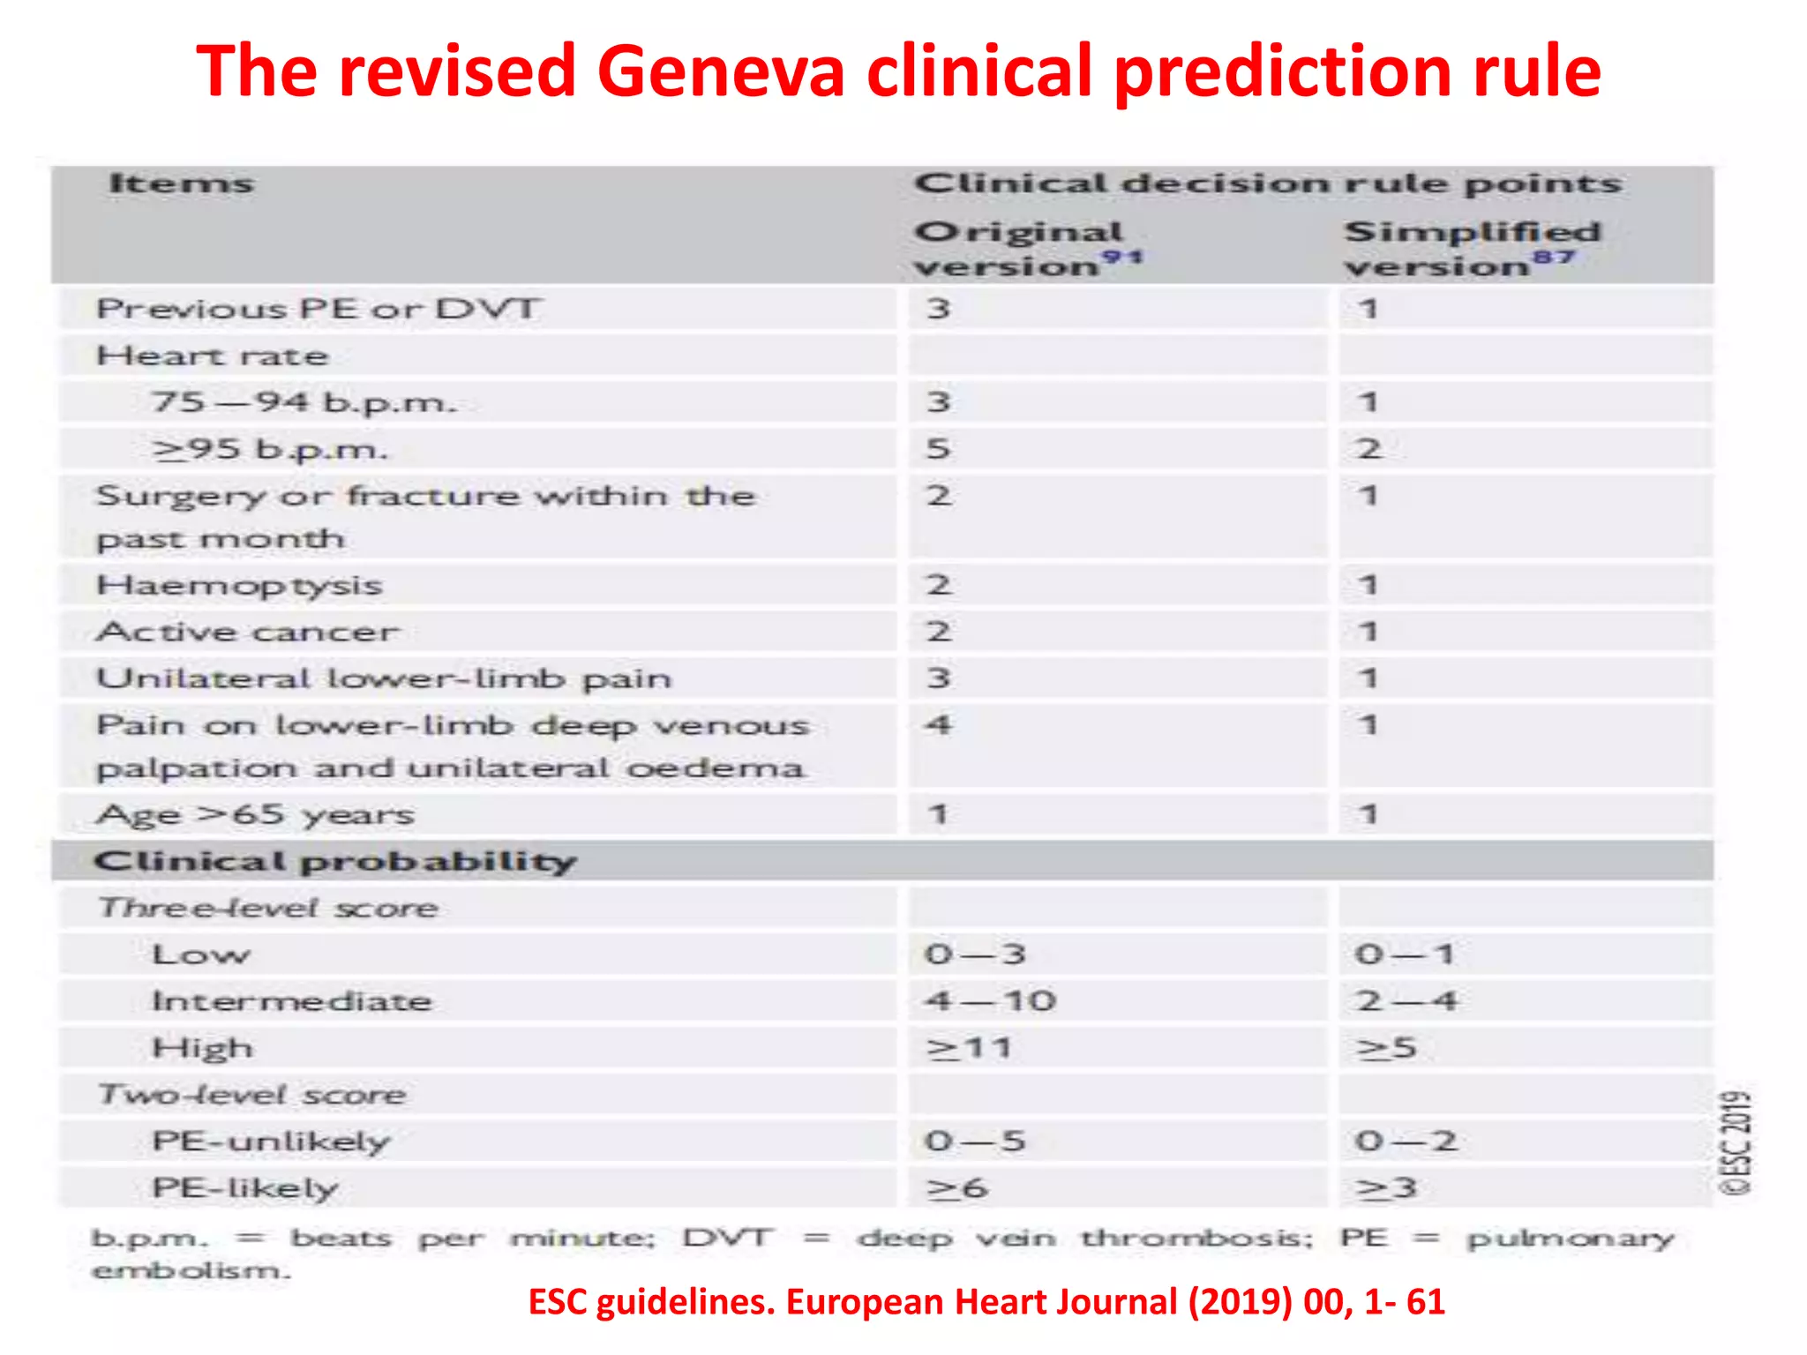
Clinical decision rule:

Slide 26
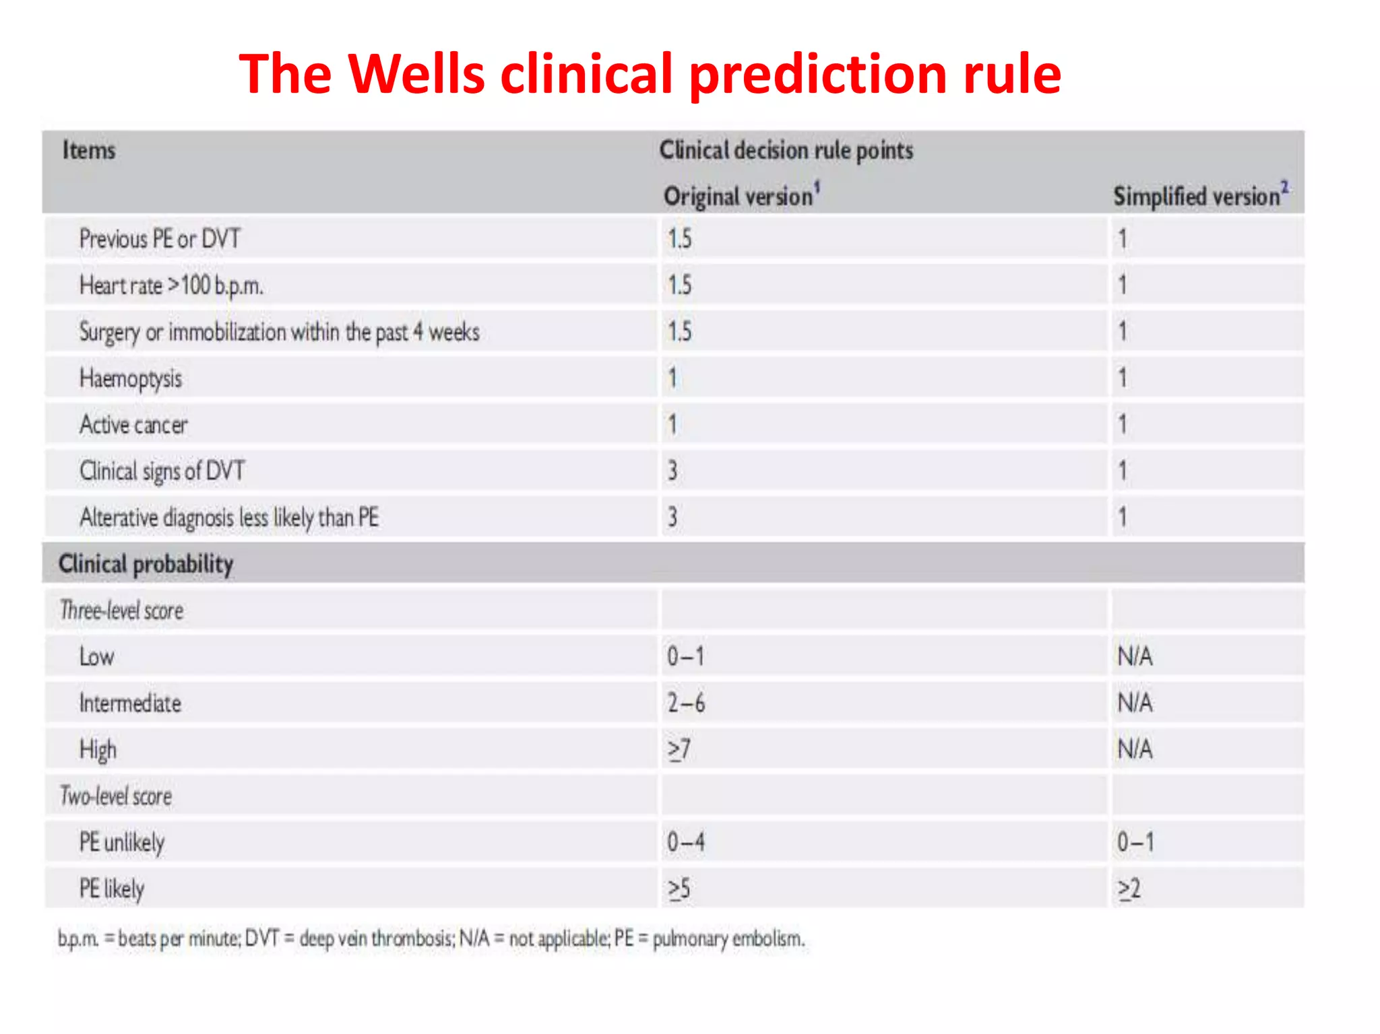
Clinical decision rule:

Slide 27
D. D. of P.E.
1- Anxiety, pleurisy, costochondritis. 2- Pneumonia, bronchitis.
-MI.
-Pericarditis.
-Congestive Heart failure.
6- Idiopathic pulm. HTN.

Slide 28
Investigation
Basic testing may include:
Lab tests (D -dimer,CBC, urea &creatinine)
Chest X-ray
Electrocardiogram
Echocardiography
Other invstigation
CT pulmonary angiography
Ventilation-perfusion scans
pulmonary angiography
Venous Doppler study

Slide 29
CXR
A near-normal CXR in the setting of severe respiratory compromise is highly suggestive of massive P.E.
CXR may show:-
-Focal oligemia (wester mark sign)
-A peripheral wedge shaped density above the diaphragm (Hampton hump) - > indicate pulm. infarction

Slide 30
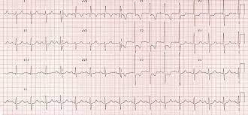
ECG
The EKG may be usually normal, but may demonstrate
-Sinus tachycardia (heart rate > 100 bpm).
-Deep S in lead I , Q wave and inverted T wave in lead III
Big size PE may produce right side strain pattern
The EKG can demonstrate a right heart strain.

Slide 31
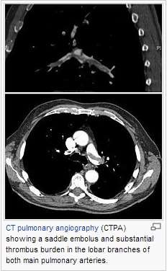
CT scan
If there is greater suspicion, then computerized tomography (CT scan) of the chest with
angiography can be done.
Contrast dye is injected into an intravenous line in the arm while the CT is being taken, and the pulmonary arteries can be
visualized.

Slide 32
Treatment of pulmonary embolism
-The best treatment for a pulmonary embolus is prevention.
-Minimizing the risk of deep vein thrombosis is key in preventing a potentially fatal illness.
-The initial decision is whether the patient requires hospitalization.
-Recent studies suggest that those patients with a small pulmonary embolus, who are hemodynamically stable (normal vital signs) may be treated at home with close outpatient care.

Slide 33
Anticoagulation
The first step in stable patients with pulmonary embolism is anticoagulation.
This is usually done with subcutaneous, weight adjusted low-molecular weight heparin (LMWH) or unfractionated heparin (UFH).
An equally rapid anticoagulant effect can also be achieved with a nonvitamin K antagonist oral anticoagulant (DOAC)

Slide 34
When VKAs are used, anticoagulation with UFH, LMWH ,should be continued in parallel with the oral anticoagulant for >_5 days and until the international normalized ratio (INR) value has been 2.0-3.0 for 2 consecutive days

Slide 35
Thrombolytic therapy
Pulmonary embolism can be fatal, especially if involves a large amount of clot.
Thrombolytic therapy using medications like TPA (tissue plasminogen activator) is recommended in high risk acute pulmonary embolism .
In certain centers, a special procedure can be performed where is catherter is placed in the right side of the heart and the clot is essentially vacuumed out.

Slide 36
Acute High risk PE
Cardiac arrest
Obstructive shock (systolic Blp less than 90 mmHg+ end organ hypoperfusion )
Persistent hypotension (systolic Blp 90 mmHg more than 15 min not caused by hypovolemia or sepsis )
---If one of the above clinical manifestation present patient is considered hemodynamically unstable

Slide 37
Optimal Duration of Anticoagulation
Clinical setting | Recommendation
First provoked PE/proximal leg DVT | 3 mo
First provoked upper extremity DVT or isolated calf DVT | 3 mo
Second provoked VTE | indefinite duration
Cancer | >6 months /until cancer is cured /indefinite

Slide 38
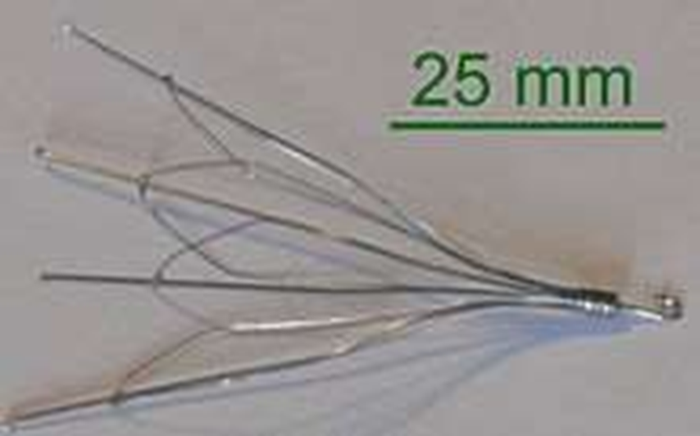
Inferior vena cava filter
Used inferior vena cava filter.
If anticoagulant therapy is contraindicated and/or ineffective, or to prevent new emboli from entering the pulmonary artery and combining with an existing blockage, an inferior vena cava filter may be implanted

Slide 39
Clinical syndrome of P.E.
Classificati on | Presentation | Therapy
Massive P.E. | Systemic B.P. < 90 mmHg Or poor tissue perfusion or multisystem organ faliure Plus :- right or left main pulm, artery thrombosis or high clot burden | Thrombolysis or embolictomy or IVC filter plus:- anti co- ag.
Submassive P.E. | Hemodynamically stable but moderate or sever R.V. dysfunction or enlargement. | Addition of thrombolysis emboletomy or filter remains controversal
Small to moderate P.E. | Normal hemodynamic of normal R.V. size & function. Pulm. infarction. | Anti co-ag.
Paradoxical embolism | A sudden stroke & concomitant V.T.E. DVT --> thrombus --> arterial system through P.F.O. | Anti co-ag

Slide 40
PULMONARY HYPERTENSION

Slide 41
Indented Learning Outcomes (ILOs)
Define PH
Identify classes of PH
Identify pathophysiology of PH
List clinical picture of PH
Enumerate diagnostic tools of PH
outline treatment modalities of PH

Slide 42
Definition of PAH
Increase in blood pressure in pulmonary circulation ( either in the arteries, or both in arteries and veins)
Normal pressure is 14-18mmHg at rest.
Hemodynamically it is defined as an increased mean pulmonary arterial pressure to >20mmHg at rest.
Can be measured by right heart catheterization

Slide 43
Classifications of Pulmonary Hypertension
Pulmonary Arterial Hypertension
Pulmonary Hypertension owing to left heart disease
PH Secondary to Chronic Hypoxemia
Chronic Thrombo-Embolic Pulmonary Hypertension (CTEPH)
Pulmonary hypertension with unclear etiology

Slide 44
Pulmonary hypertension due to left heart disease
Systolic dysfunction
Diastolic dysfunction
Valvular disease

Slide 45
Pulmonary hypertension associated with lung disease and/or hypoxemia
Chronic obstructive lung disease
Interstitial lung disease
Sleep-disordered breathing
Alveolar hypoventilation disorders
Chronic exposure to high altitude
Developmental abnormalities

Slide 46
Pulmonary hypertension due to chronic thrombotic and/or embolic disease
Thromboembolic obstruction of proximal pulmonary arteries
Thromboembolic obstruction of distal pulmonary arteries

Slide 47
Unclear /multifactorial etiology
Hematological disorders
Systemic disorders :ex.sarcoidosis ….
Metabolic disorders :Glycogen storage disease
Pulmonary tumour thrombotic microangiopathy

Slide 48
Pathophysiology of pulmonary hypertension

Slide 49
Pathogenesis of Pulmonary Arterial Hypertension
Excessive vasoconstriction.
Endothelial dysfunction leads to chronically impaired production of vasodilator and Vasoconstrictors
Reduced plasma levels of other vasodilator and antiproliferative substances
In the adventitia there is increased production of extracellular matrix
Prothrombotic abnormalities have been demonstrated in PAH patients.

Slide 50
Pathogenesis of Pulmonary Hypertension du to left heart disease
Pulmonary venous hypertension-most common cause
Usually due to left-sided heart disease (valvular, coronary or myocardial ),
Obstruction to blood flow downstream from the pulmonary veins.
Reversibility is variable, dependent on lesion.

Slide 51
Pathogenesis of Pulmonary Hypertension due to thrombo-embolism
CTEPH: non-resolution of acute embolic masses which later undergo fibrosis leading to mechanical obstruction of pulmonary arteries is the most important process.

Slide 52
Symptoms of pulmonary hypertension
Dyspnea
Fatigue
Near syncope/syncope
Chest pain
Palpitations
LL edema
Hoarseness of voice (Ortners syndrome)

Slide 53
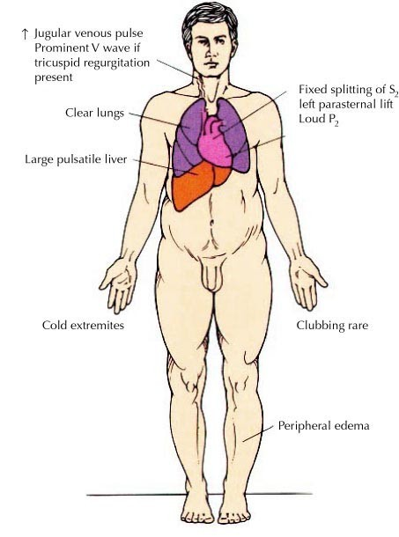
Signs of PH

Slide 54
How to diagnose PH
Chest X ray
ECG
Echocardiography
Right side heart cath
Investigations to diagnose etiology

Slide 55
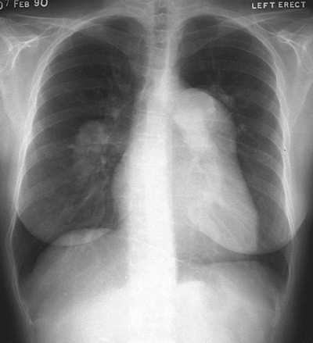
CXR in PH
Large central Pulmonary arteries
Right Ventricular Hypertrophy
Rapid attenuation of pulmonary vessels
Clear Lung Fields

Slide 56
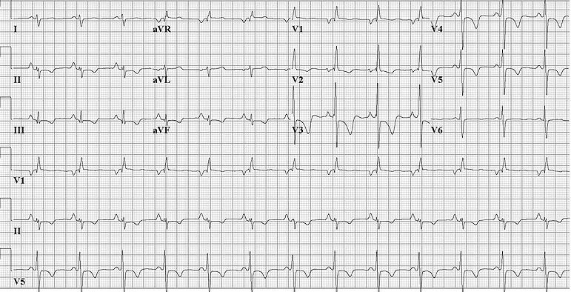
ECG in PH
Right axis deviation
R wave/S ≥ in V1
Incomplete or complete RBBB
P pulmonale

Slide 57
Echocardiogram Findings
TR velocity & systolic pulmonary artery pressure
Right atrial and ventricular hypertrophy
Flattening of interventricular septum Small LV dimension
Dilated PA

Slide 58
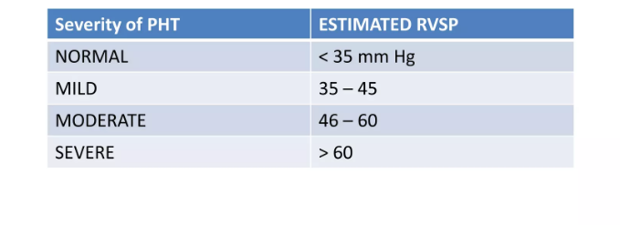
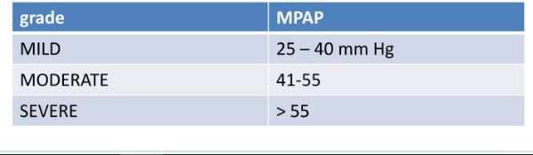
Grades of pulmonary hypertension

Slide 59
Management of pulmonary hypertension
General measures:
Treat the underlying disease
Avoid pregnancy
Contraception imperative
Maternal mortality 30%
Immunizations for respiratory illnesses
Influenza & pneumonia vaccinations
Minimize valsalva maneuvers— increase risk of syncope
Cough, constipation, heavy lifting, etc

Slide 60
Management of pulmonary hypertension
Medical therapy
Diuretics
Anti coagulants (IPAH) Digoxin
Oxygen
PAH specific therapy
Surgical therapy
Atrial septostomy
Lung transplantation

Slide 61
MCQ
A 68 years old male patient presented to ER by acute stitching chest pain and dyspnea began 6 hours ago
-He was bed ridden over 5 weeks due to a cast in his left leg which is now swollen and tens up to knee
-His Blp is 90/60 mmHg, HR is 120 bpm, Temperature 37.2 C , ECG : deep S in lead I , Q wave and inverted T wave in lead III with RV stain pattern
Echo :Moderate TR ,moderate PHTN ,Dilated RV, other wise no remarkable abnormality –
-Q1-What is the most probable diagnosis :
A-This patient has ST – segment myocardial infarction
B-This patient has only pleurisy
C- This patient is just anxious
D- This patient has just costochondritis
E-This patient most probably has pulmonary embolism

Slide 62
Q2 –What is the most probable simplified wells score of this patient?
A-0
B-1
C-2
D-4
E -6

Slide 63
Answers :
Q1-E
Q2-D

Slide 64
Take home massages
-Deep venous thrombosis(DVT) and pulmonary embolism have the same risk factors
-The most fatal complication of DVT is pulmonary embolism
-Early recognition and proper management of pulmonary embolism are crucial
-Pulmonary hypertension has several classes and right heart catheterization is the most important method of its diagnosis

Slide 65
THANK YOU

